Slide 1
Fast 4DCBCT
Applying advances in
acquisition and reconstruction to reduce scan time and dose
Owen Dillon, Ricky O’Brien, Chun-Chien Shieh, Paul Keall

Slide 2
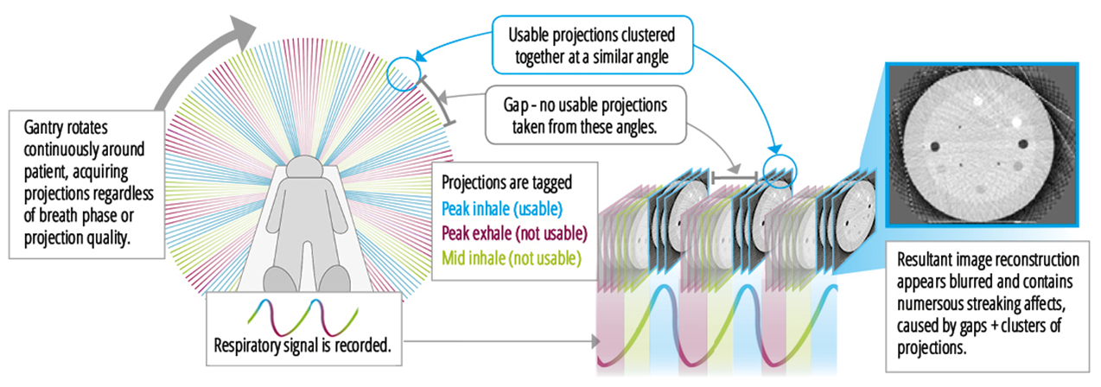
The Problem
Immediately before a thoracic treatment fraction a 4 minute long, 1,320 projection CBCT is performed to check alignment with the plan.
We are investigating improved acquisition and reconstruction to reduce the scan time and dose while retaining image quality.

Slide 3
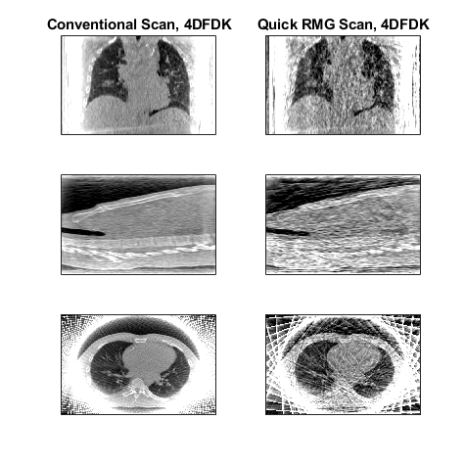
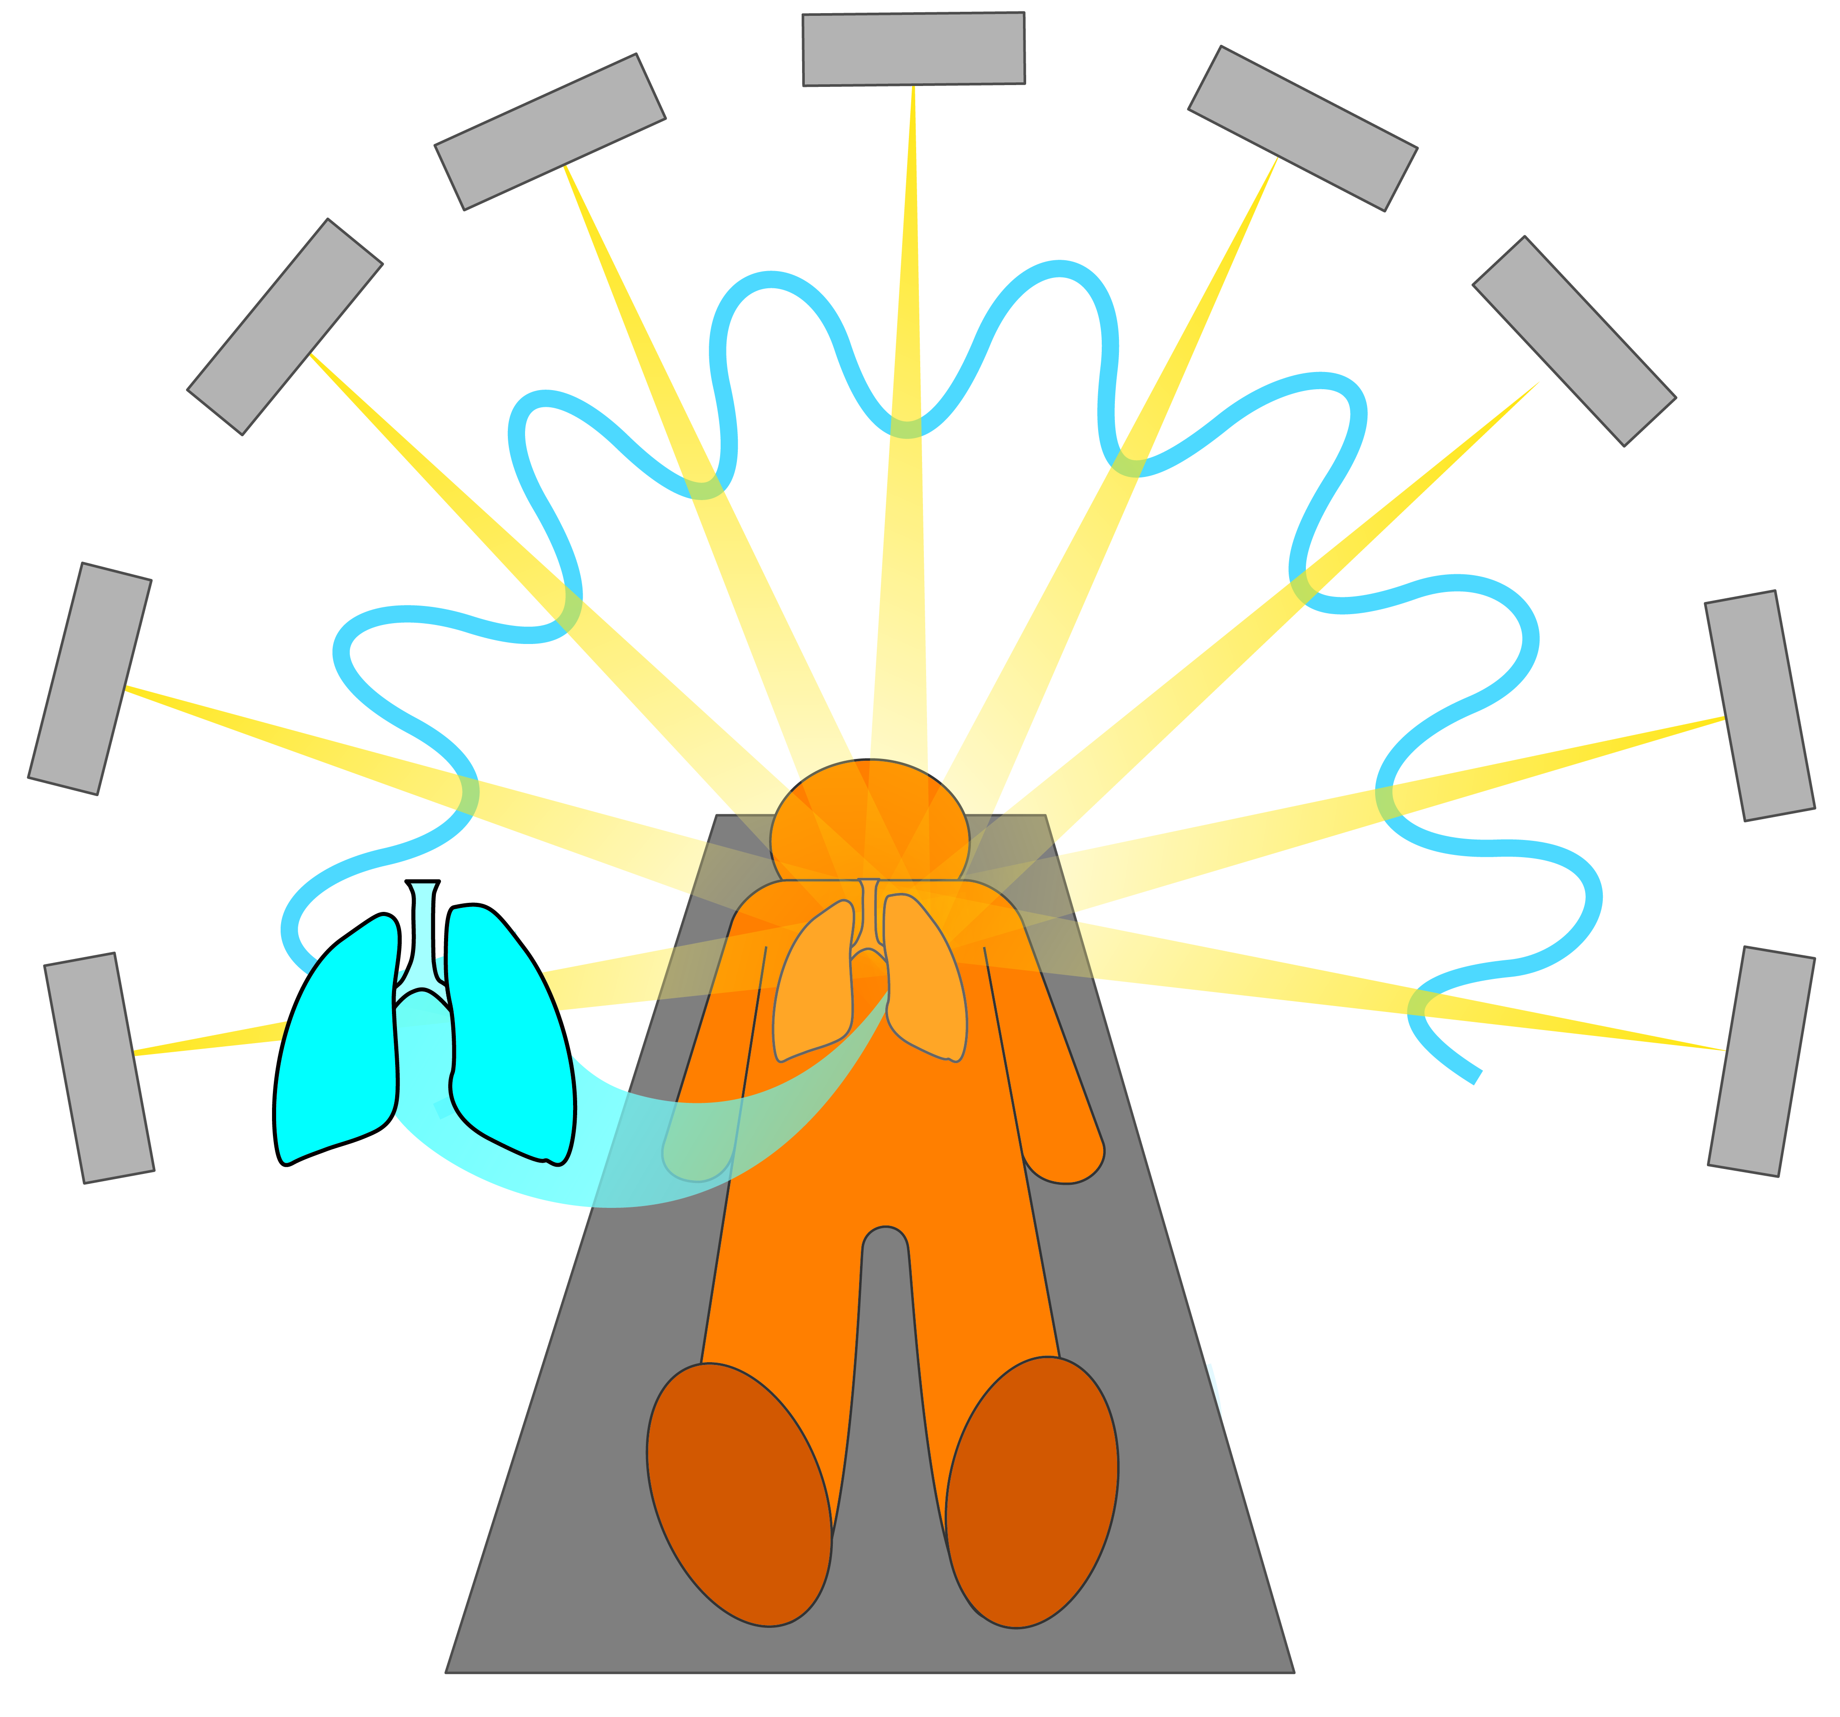
Improving Acquisition
Use Respiratory-Motion-Guidance for a 200 projection, 80 second scan.

Slide 4
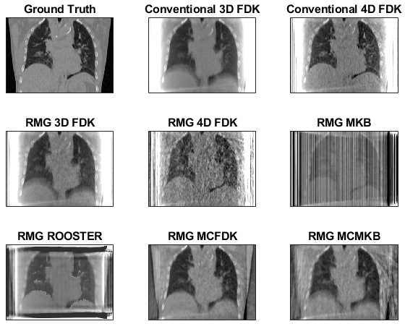

Slide 5
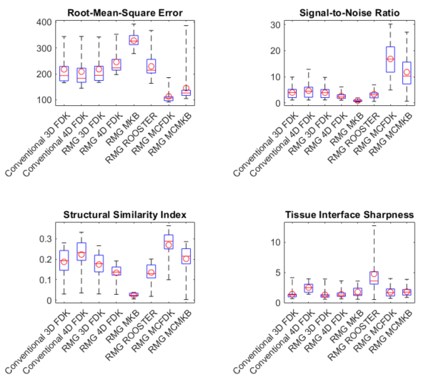
Better
Better
Find that MCFDK reconstructions from RMG quick scans have similar or better quality than standard 4DFDK reconstructions from conventional scans.
This is particularly good as MCFDK and FDK have comparable computational cost.
Better
Better

Slide 6

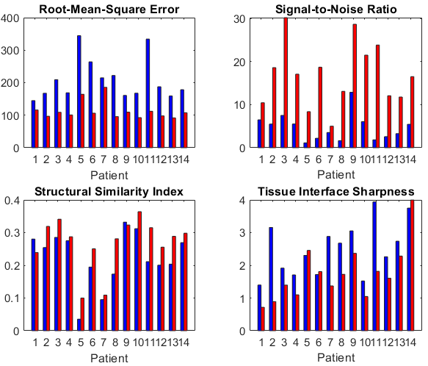
Better
Better
Better
Better

Slide 7
Conclusions
We propose a Respiratory-Motion-Guided quick scan protocol that reduces scan time 75% and reduces dose 80%.
The 4D FDK reconstruction from quick scan data has unacceptably low image quality compared to standard 4D FDK reconstruction from conventional scan data.
For each metric considered a reconstruction method was found that delivered comparable quality using quick scan data against 4D FDK using conventional scan data, however the computational cost may negate scan time reduction on current hardware.
The MCFDK reconstruction has generally comparable image quality compared to standard 4D FDK reconstruction from conventional scan data for comparable computational cost.

