Slide 1
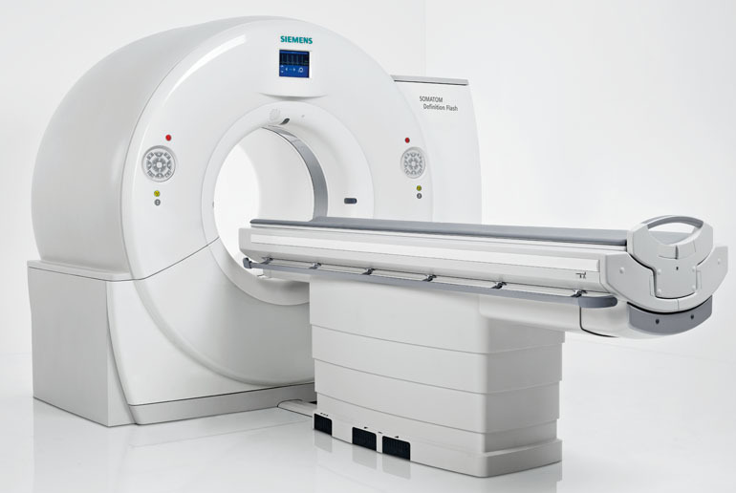
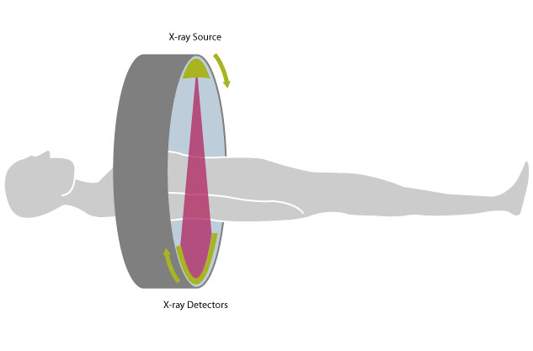
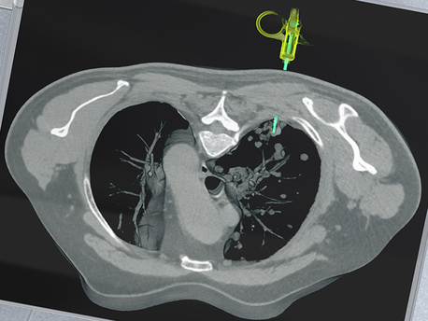
X-Ray Computed
Tomography
By Owen Dillon

Slide 2
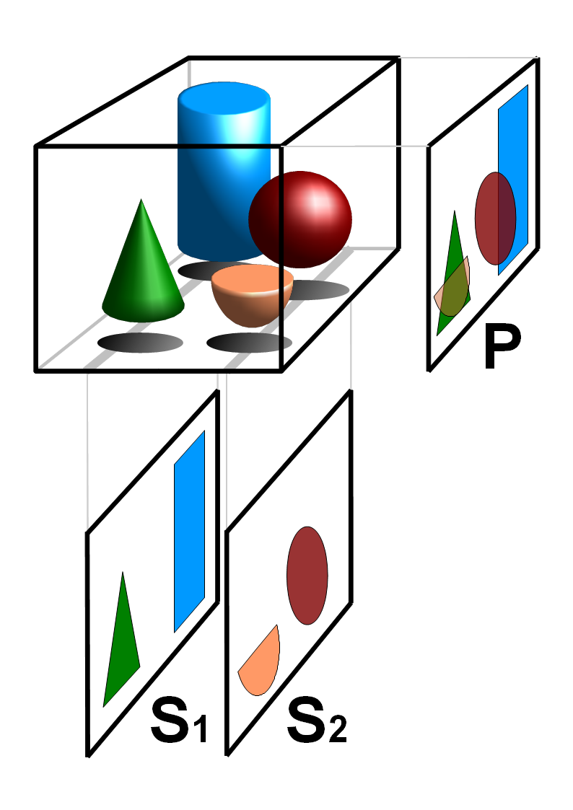
What is it?
X-rays are a type of light that mostly pass through people.
When we shine x-rays on a person we can get a shadow image through their anatomy.
Tomography just means viewing individual slices of an object.
Computers let us turn shadow images into tomographic images.

Slide 3
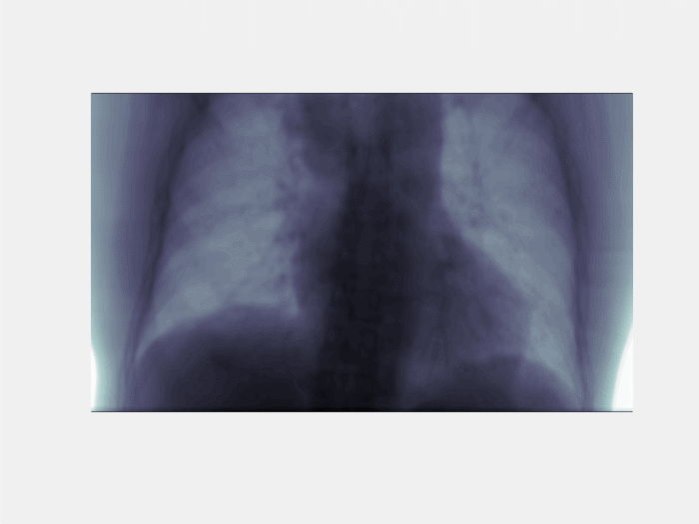
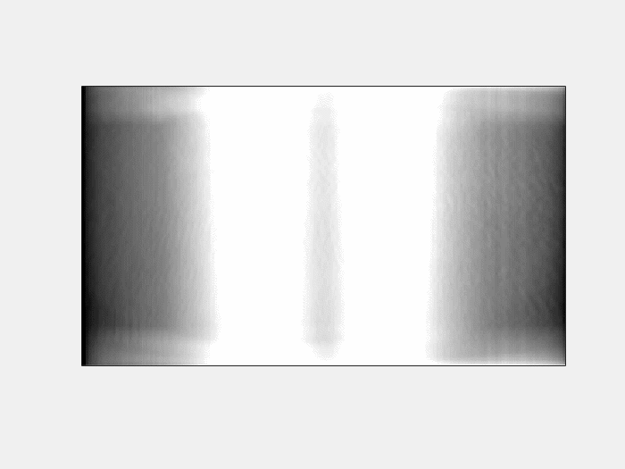
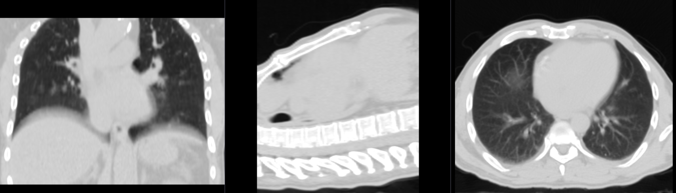

Slide 4
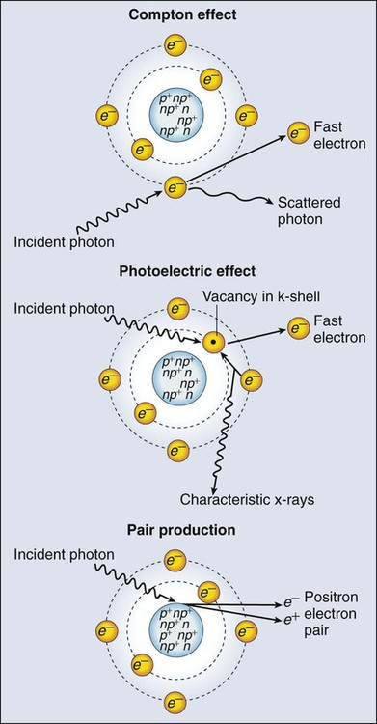


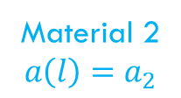
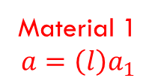


How it works: x-rays
The rate at which x-ray beam intensity reduces is proportional to the electron density in the path.
Intensity
$$a_{1}>a_{2}$$
Empty
space
Material 1
$$a=\left(l\right)a_{1}$$
Material 2
$${a\left(l\right)=a}_{2}$$
Empty
space
$$\frac{dI}{dl}=−x\left(l\right)I(l)$$
Distance $l$
$$I=I_{0}e^{−a\left(l\right)l}$$

Slide 5


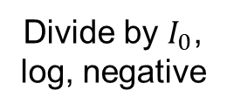
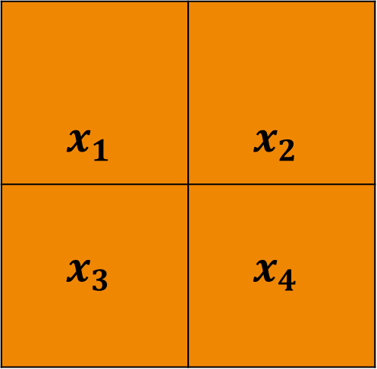



How it works: Tomography
$$l_{1}$$
$$l_{2}$$
$$x_{1}$$ | $$x_{2}$$
$$x_{3}$$ | $$x_{4}$$
$$I_{0}$$
$$I_{0}e^{−(x_{1}l_{1}+x_{2}l_{2})}$$
Divide by $I_{0}$,
log, negative
$$x_{1}l_{1}+x_{2}l_{2}$$

Slide 6
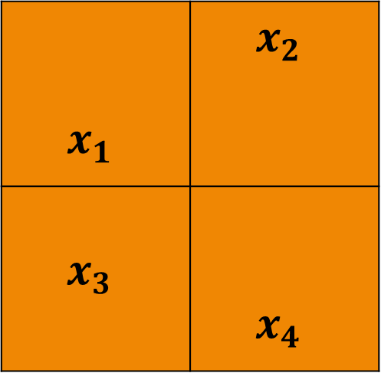




How it works: Tomography
$$l_{1}$$
$$x_{1}$$ | $$x_{2}$$
$$x_{3}$$ | $$x_{4}$$
$$l_{2}$$
$$l_{3}$$
$$x_{1}l_{1}+x_{2}l_{2}+x_{3}l_{3}$$

Slide 7
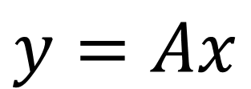
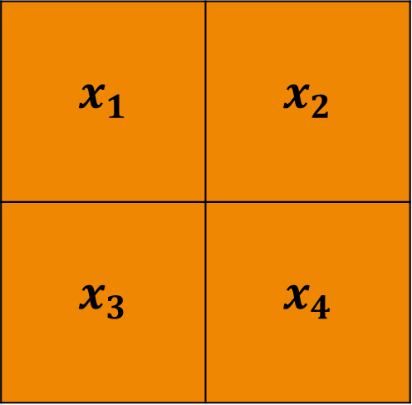




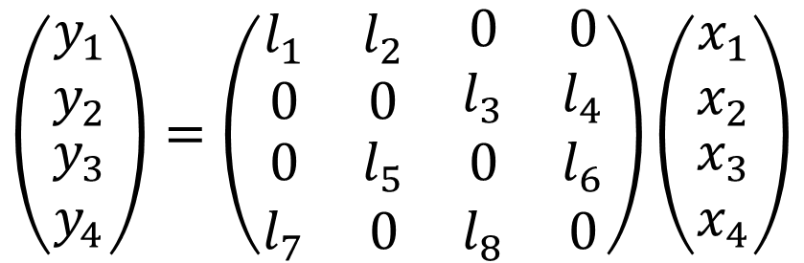
$$x_{1}l_{1}+x_{2}l_{2}=y_{1}$$
$$x_{1}$$ | $$x_{2}$$
$$x_{3}$$ | $$x_{4}$$
$$x_{3}l_{3}+x_{4}l_{4}=y_{2}$$
$$y=Ax$$
$$\left(\begin{matrix}\begin{matrix}y_{1} \\ y_{2}\end{matrix} \\ \begin{matrix}y_{3} \\ y_{4}\end{matrix}\end{matrix}\right)=\left(\begin{matrix}\begin{matrix}l_{1} & l_{2} \\ 0 & 0\end{matrix} & \begin{matrix}0 & 0 \\ l_{3} & l_{4}\end{matrix} \\ \begin{matrix}0 & l_{5} \\ l_{7} & 0\end{matrix} & \begin{matrix}0 & l_{6} \\ l_{8} & 0\end{matrix}\end{matrix}\right)\left(\begin{matrix}\begin{matrix}x_{1} \\ x_{2}\end{matrix} \\ \begin{matrix}x_{3} \\ x_{4}\end{matrix}\end{matrix}\right)$$
$$x_{1}l_{7}+x_{3}l_{8}=y_{4}$$
$$x_{2}l_{5}+x_{4}l_{6}=y_{3}$$

Slide 8
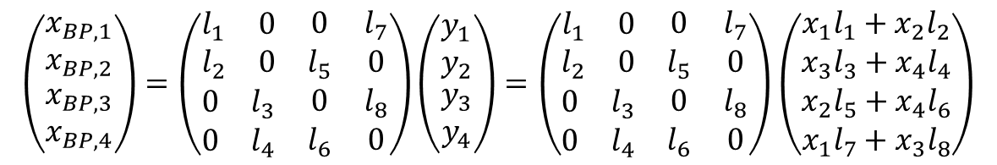
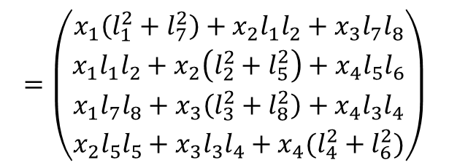

Back Projection
$$x_{BP}=A^{T}y$$
$$\left(\begin{matrix}\begin{matrix}x_{BP,1} \\ x_{BP,2}\end{matrix} \\ \begin{matrix}x_{BP,3} \\ x_{BP,4}\end{matrix}\end{matrix}\right)=\left(\begin{matrix}\begin{matrix}l_{1} & 0 \\ l_{2} & 0\end{matrix} & \begin{matrix}0 & l_{7} \\ l_{5} & 0\end{matrix} \\ \begin{matrix}0 & l_{3} \\ 0 & l_{4}\end{matrix} & \begin{matrix}0 & l_{8} \\ l_{6} & 0\end{matrix}\end{matrix}\right)\left(\begin{matrix}\begin{matrix}y_{1} \\ y_{2}\end{matrix} \\ \begin{matrix}y_{3} \\ y_{4}\end{matrix}\end{matrix}\right)=\left(\begin{matrix}\begin{matrix}l_{1} & 0 \\ l_{2} & 0\end{matrix} & \begin{matrix}0 & l_{7} \\ l_{5} & 0\end{matrix} \\ \begin{matrix}0 & l_{3} \\ 0 & l_{4}\end{matrix} & \begin{matrix}0 & l_{8} \\ l_{6} & 0\end{matrix}\end{matrix}\right)\left(\begin{matrix}\begin{matrix}x_{1}l_{1}+x_{2}l_{2} \\ x_{3}l_{3}+x_{4}l_{4}\end{matrix} \\ \begin{matrix}x_{2}l_{5}+x_{4}l_{6} \\ x_{1}l_{7}+x_{3}l_{8}\end{matrix}\end{matrix}\right)$$
$$=\left(\begin{matrix}\begin{matrix}x_{1}\left(l_{1}^{2}+l_{7}^{2}\right)+x_{2}l_{1}l_{2}+x_{3}l_{7}l_{8} \\ x_{1}l_{1}l_{2}+x_{2}\left(l_{2}^{2}+l_{5}^{2}\right)+x_{4}l_{5}l_{6}\end{matrix} \\ \begin{matrix}x_{1}l_{7}l_{8}+x_{3}\left(l_{3}^{2}+l_{8}^{2}\right)+x_{4}l_{3}l_{4} \\ x_{2}l_{5}l_{5}+x_{3}l_{3}l_{4}+x_{4}(l_{4}^{2}+l_{6}^{2})\end{matrix}\end{matrix}\right)$$
Basically just smearing each projection backwards.
As we smear more and more projections backwards, converge towards a solution

Slide 9
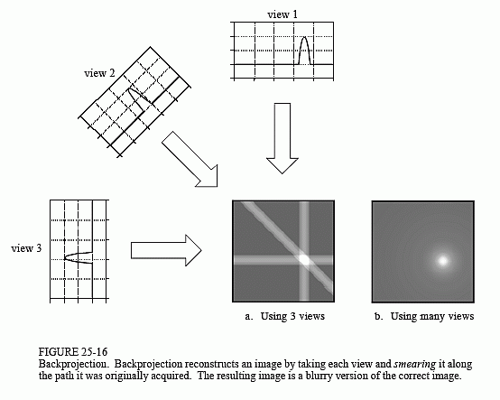
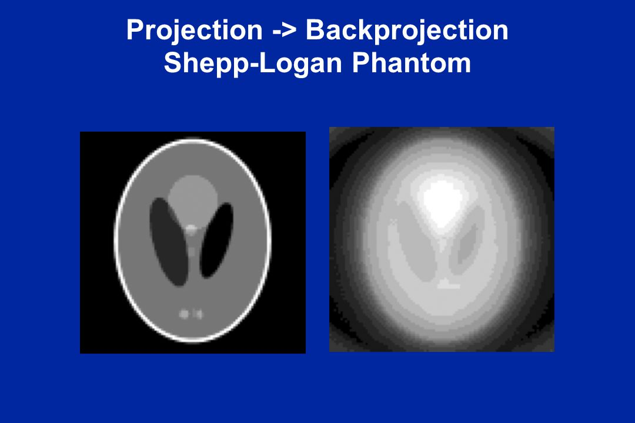

Slide 10
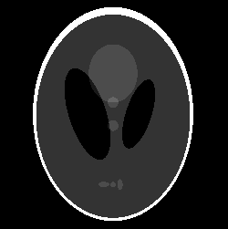
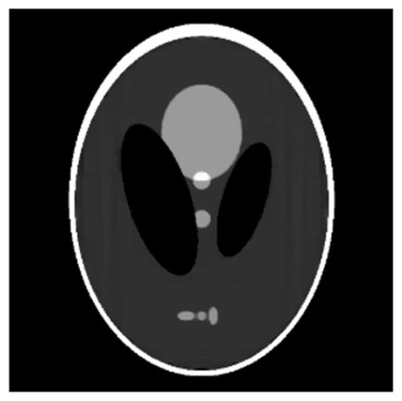
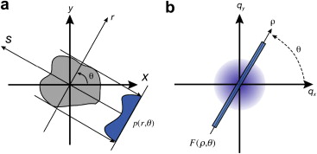
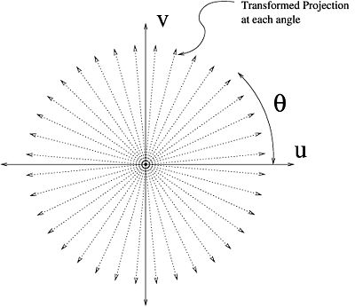
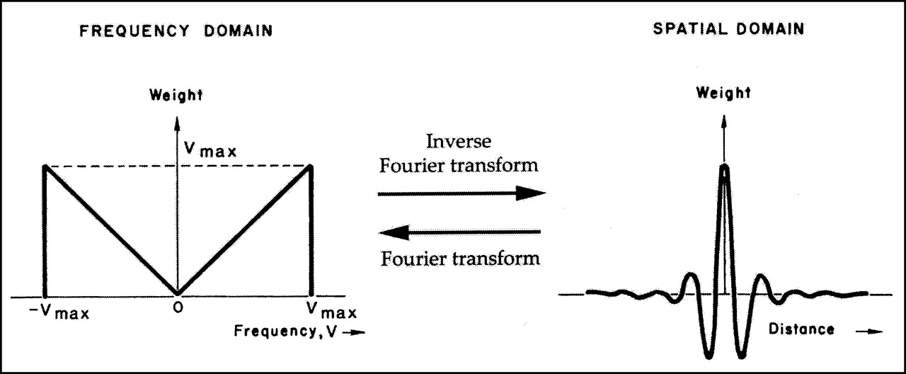
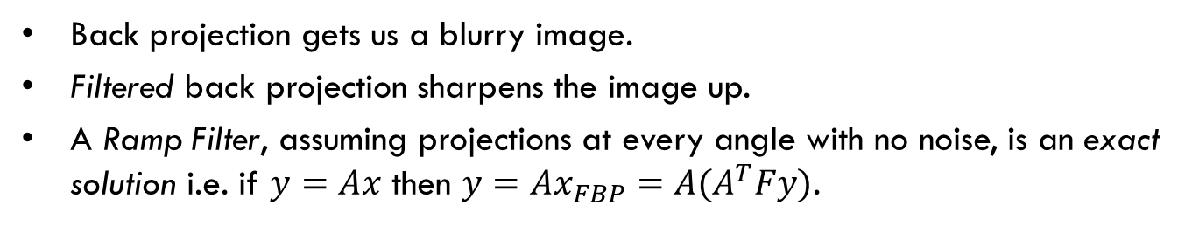
Filtered Back Projection
Back projection gets us a blurry image.
Filtered back projection sharpens the image up.
A Ramp Filter, assuming projections at every angle with no noise, is an exact solution i.e. if $y=Ax$ then ${y=Ax}_{FBP}=A(A^{T}Fy)$.

Slide 11
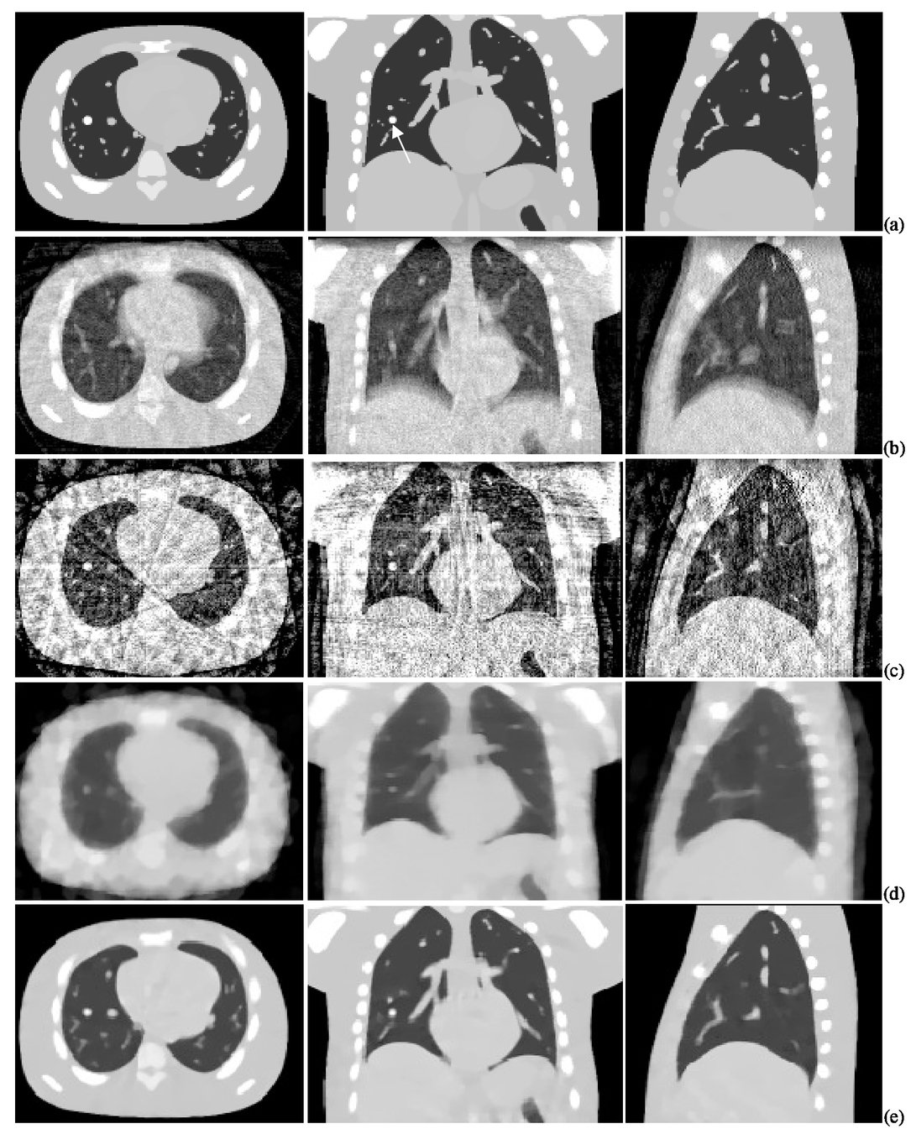
A Perfect Solution in an Imperfect World
Applying a filter and backprojecting is fast and solves the complete and perfect problem.
We don’t have complete and prefect data.
We can construct different reconstruction algorithms with different assumptions which may deal with different types of imperfections better.

Slide 12
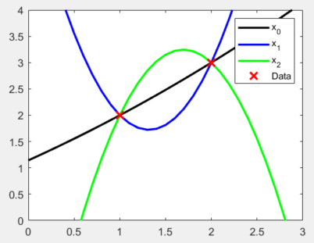

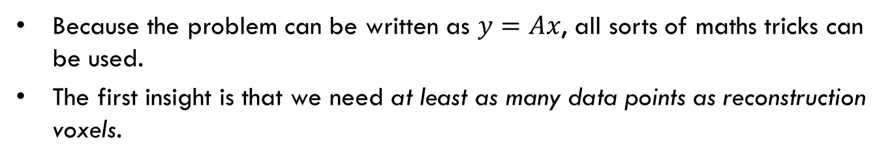
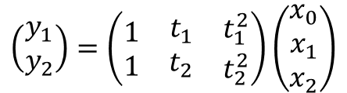
Iterative methods
Because the problem can be written as $y=Ax$, all sorts of maths tricks can be used.
The first insight is that we need at least as many data points as reconstruction voxels.
$$y=x_{0}+x_{1}t+x_{2}t^{2}=Ax$$
$$\left(\begin{matrix}y_{1} \\ y_{2}\end{matrix}\right)=\left(\begin{matrix}\begin{matrix}1 \\ 1\end{matrix} & \begin{matrix}t_{1} \\ t_{2}\end{matrix} & \begin{matrix}t_{1}^{2} \\ t_{2}^{2}\end{matrix}\end{matrix}\right)\left(\begin{matrix}x_{0} \\ x_{1} \\ x_{2}\end{matrix}\right)$$

Slide 13

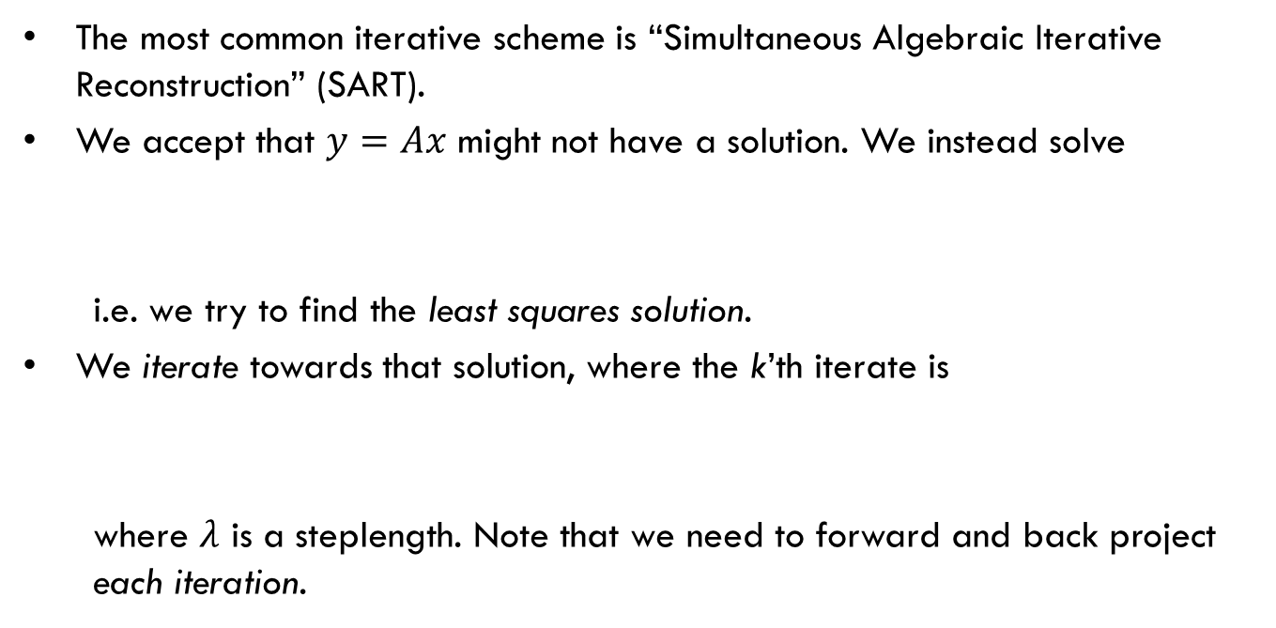
Standard Iterative: SART
The most common iterative scheme is “Simultaneous Algebraic Iterative Reconstruction” (SART).
We accept that $y=Ax$ might not have a solution. We instead solve
i.e. we try to find the least squares solution.
We iterate towards that solution, where the k’th iterate is
where $λ$ is a steplength. Note that we need to forward and back project each iteration.
$$x_{SART}= \min_{x}\left\{{\left\|y −Ax\right\|}_{2}\right\}$$
$$x_{SART}^{k+1}=x_{SART}^{k}+λ\left(A^{T}Ax_{SART}^{k}−A^{T}y\right)$$

Slide 14
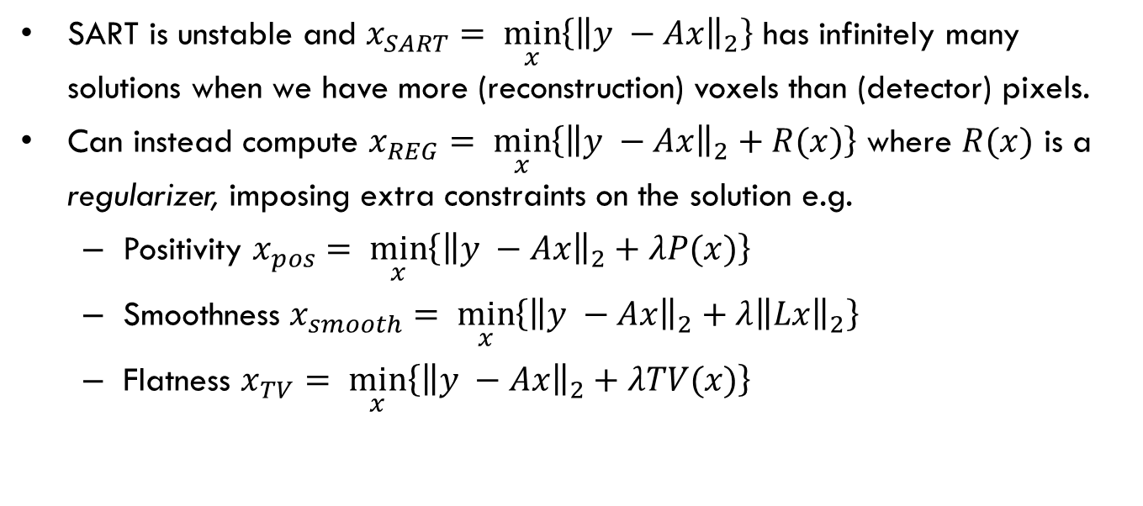
Regularization
SART is unstable and $x_{SART}= \min_{x}\left\{{\left\|y −Ax\right\|}_{2}\right\}$ has infinitely many solutions when we have more (reconstruction) voxels than (detector) pixels.
Can instead compute $x_{REG}= \min_{x}\left\{{\left\|y −Ax\right\|}_{2}+R(x)\right\}$ where $R(x)$ is a regularizer, imposing extra constraints on the solution e.g.
  Positivity $x_{pos}= \min_{x}\left\{{\left\|y −Ax\right\|}_{2}+λP(x)\right\}$
  Smoothness $x_{smooth}= \min_{x}\left\{{\left\|y −Ax\right\|}_{2}+λ{\left\|Lx\right\|}_{2}\right\}$
  Flatness $x_{TV}= \min_{x}\left\{{\left\|y −Ax\right\|}_{2}+λTV(x)\right\}$

Slide 15
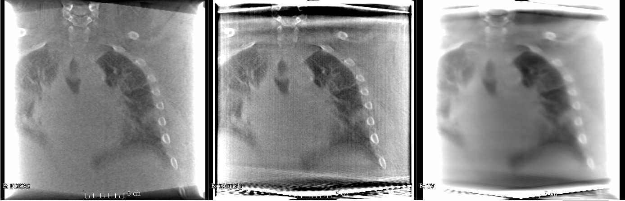
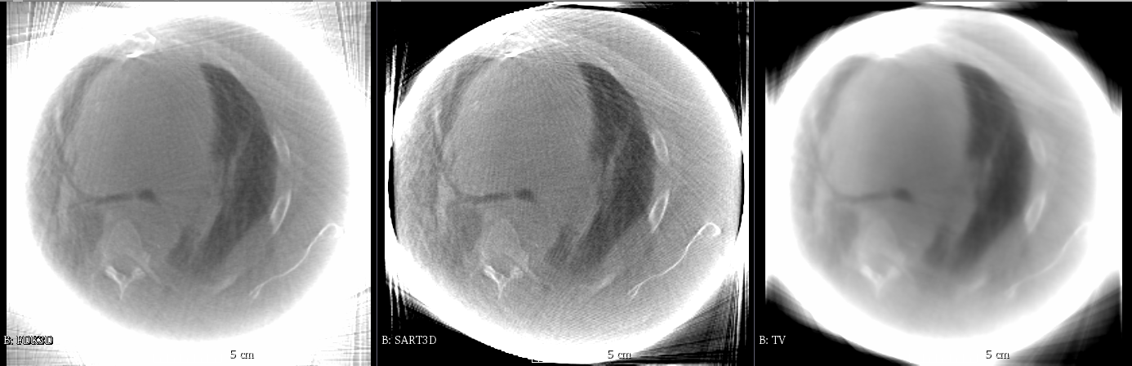

Slide 16
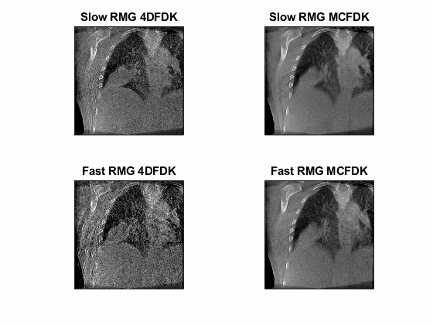
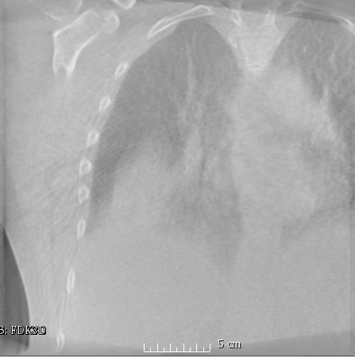
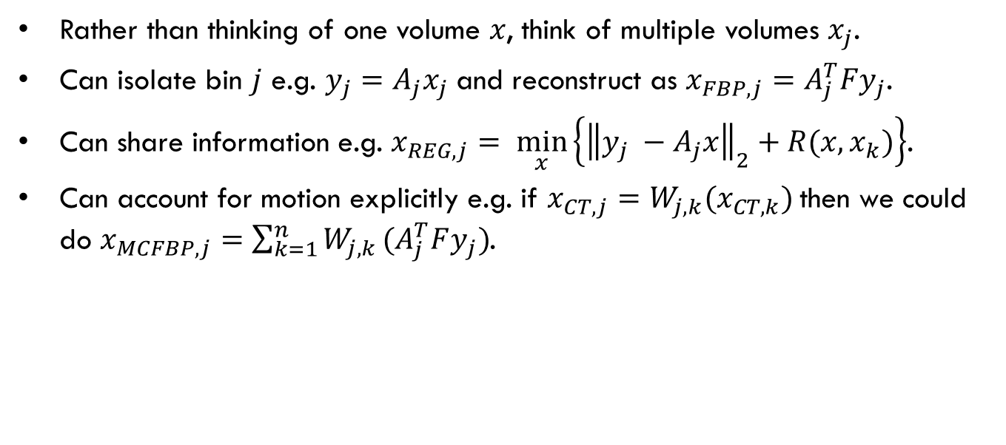
Motion Compensation
Rather than thinking of one volume $x$, think of multiple volumes $x_{j}$.
Can isolate bin $j$ e.g. $y_{j}=A_{j}x_{j}$ and reconstruct as $x_{FBP,j}=A_{j}^{T}Fy_{j}$.
Can share information e.g. $x_{REG,j}= \min_{x}\left\{{\left\|y_{j} −A_{j}x\right\|}_{2}+R(x,x_{k})\right\}$.
Can account for motion explicitly e.g. if $x_{CT,j}=W_{j,k}(x_{CT,k})$then we could do $x_{MCFBP,j}=\sum_{k=1}^{n}{W_{j,k}}(A_{j}^{T}Fy_{j})$.

Slide 17
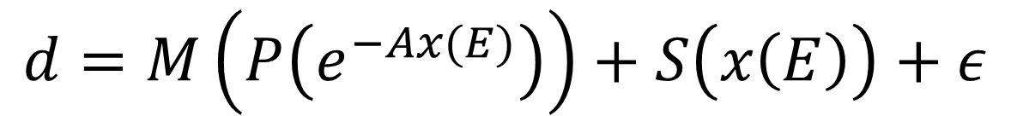
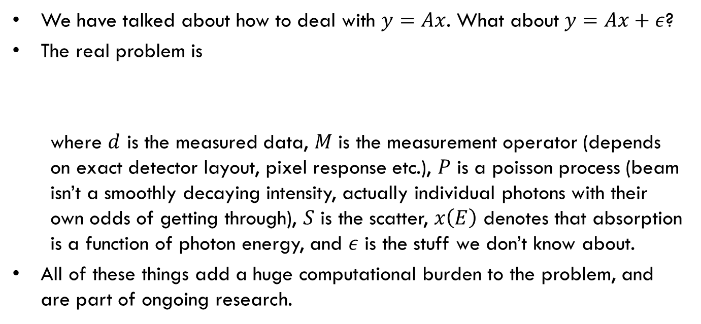
The Real Equation
We have talked about how to deal with $y=Ax$. What about $y=Ax+ε$?
The real problem is
where $d$ is the measured data, $M$ is the measurement operator (depends on exact detector layout, pixel response etc.), $P$ is a poisson process (beam isn’t a smoothly decaying intensity, actually individual photons with their own odds of getting through), $S$ is the scatter, $x\left(E\right)$ denotes that absorption is a function of photon energy, and $ε$ is the stuff we don’t know about.
All of these things add a huge computational burden to the problem, and are part of ongoing research.
$$d=M\left(P\left(e^{−Ax(E)}\right)\right)+S\left(x\left(E\right)\right)+ε$$

Slide 18
Thanks for
Listening!

